Slide 1
How to Register for the TOPIK Test (한국어능력시험)

Slide 2
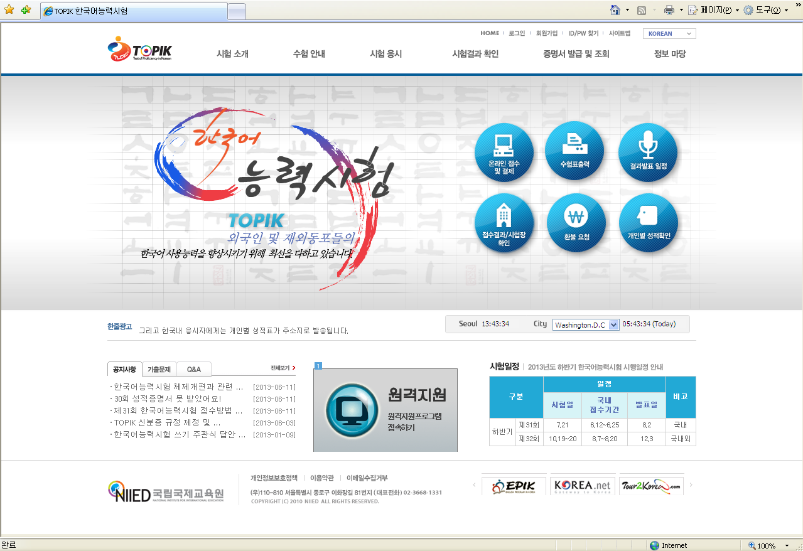
www.topik.go.kr

Slide 3
Part 1: The Homepage

Slide 4
Announcements
Left side (TOPIK Exam):
시험일자 = Test date
접수기간 = Registration date
결제기간 = Payment period
환불기간 = Refund period
수험표출력기간 = Ticket output period
성적발표 = Results
Right (Mock Exam 모의시험):
대상자 = Test name
시험일시 = Test times
접수기간 = Registration date
모의시험장소 = Location
모의시험 응시를 원하는 … = “If you want the mock test…”
To close the ads:
닫기 = Close
1일동안 열지않음 = Don’t open again for 1 day.

Slide 5
Test Regulations
Regulations will change after the 7.21 test
Currently (Changes after this test)
Division 1: If test ID is missing
Can submit within 3 days after the test
Change: Can’t take test
Division 2: Acceptable ID forms
Passport
Foreign registration card
Korean driver’s license
Korean national ID card
Student ID card (removed)
Division 3: Photo differences
Take another picture at that location if not current
Can’t take the test (if admission ticket, ID, face don’t match)
Division 4: Cheating
Receive no score
Can’t take the test for 1 year
Division 5: Someone else takes your test for you
Receive no score
Can’t take the test, 2 years
Go to court
1.
2.
3.
4.
5.

Slide 6
TOPIK Homepage (www.topik.go.kr)
Close the announcement popups.
Click “온라인 접수 및 결제” (the button with the computer) to register.

Slide 7
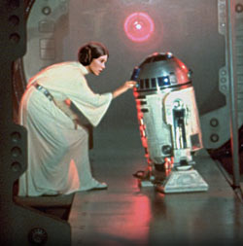
Download & Install
An ActiveX control will also appear in IE…
This page will prompt you to install:
An ActiveX control (at top)
XecureWeb (button)
Install both to continue.
(i.e. Internet Explorer = your only hope)

Slide 8
PART 2: Joining the Site

Slide 9
After installing that ActiveX stuff, join the site
Click “신규회원가입” (가입 = Join) under the black Login button.

Slide 10
Agree to everything
Just click the check box and button and move on.

Slide 11
Join form
아이디 = ID (username)
중복체크 = check available
비밀번호 = password
비밀번호 확인 = confirm password
한글성명 = name in Hangul
영문성명 = name in English
생년월일 = birth Y/M/D
성별 = sex
국적 = country
찾기 = search
회원구분 = member type
한국인 = Koreans in Korea
재외국인 = Koreans abroad
재한외국인 = Foreigners living in Korea
외국인 = Foreigners outside Korea
주소 = address
이메일 = email
전화번호 = phone #
핸드폰 = cell phone #
SMS 수신여부 = Can we send you SMS texts to your phone?
이메일 수신여부 = Can we send you email?
Check your username
Next page

Slide 12
찾기 = Search; 검색 = Select
Search for country
Search for address
Search by your 동. You may have to scroll down a bit to get to your city.

Slide 13
The Completed Form
Here’s what the completed form looks like.
Oops. I made a mistake.
I should be 재한외국인, not just 외국인 since I live in Korea.
^^;
등록 = Enroll
취소 = Cancel

Slide 14
PART 3: Registering for TOPIK

Slide 15
Now login!
(Leave the “일반회원” button checked. That means “Regular Members”. The other button is for “Managers”.)

Slide 16
Online Enrollment
1.
2.
Next slide
2 slides later
1. Top half
2. Bottom half
“Photo” details & “Testing Area” selection details on next slide
“Motive of Application” details 2 slides later

Slide 17
1. Photo & Test location details
How many spots left?
Photo specifics
Test location
Must look like a passport pic (white bg)
Have a ratio of 3:4
Be less than 200KB in size
Less than 3 months old
Select your city first
Select your testing place second
잔여인원 = Seats remaining

Slide 18
2. “Motive of Application” details
“Motive of Application”
방송 = Broadcasting
신문 = Newspaper
잡지 = Magazine
교육기관 = Educational institution
포스터 = Poster
친지 = Relative
친구 = Friend
인터넷 = Internet
기타 = Other
“Purpose of Application”
유학 = School
취업 = Job
관광 = Tourism
학술연구 = Research
실력확인 = To check your level
한국문화이해 = Understand Korean culture
기타 = Other

Slide 19
Part 4: Paying Your Dues

Slide 20
Test Payment options
Now you owe 40,000won. How will you pay?
신용카드 = Credit card
실시간 계좌이체 = Real-time bank transfer (Online. Now.)
가상계좌 = ATM transfer
I recommend the ATM transfer.
It’s the simplest method.

Slide 21
Now you pay.
Payment request page
Payment details (last 4 lines)
Check your details and fill in the phone numbers if you want.
입금은행 = Deposit bank
가상계좌주명 = Name on account
가상계좌번호 = Acct #
승인시간 = Approval time

Slide 22
Check your email for a payment reminder
입금마감일 = Payment deadline

Slide 23
Now head on over to that ATM and pay before the deadline! Good luck on TOPIK!

