Slide 1
What to Expect on the Test Date (한국어능력시험)

Slide 2
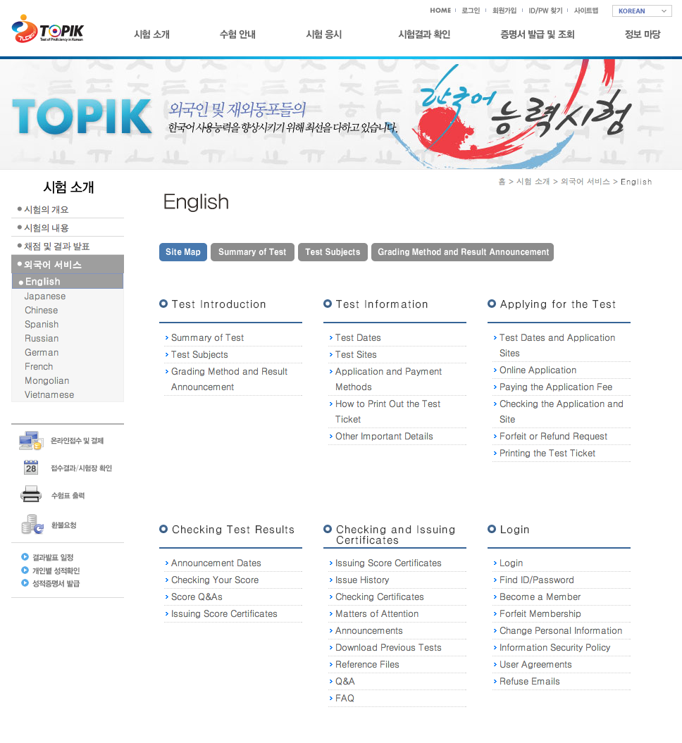
www.topik.go.kr
All the following information
can be found in the 외국어 서비스
section of the TOPIK government
website.

Slide 3
Part 1: Print your ticket

Slide 4
Homepage Notices
Left side (TOPIK Exam Notice):
시험일자 = Test date
시험시간 = Test time
초/고급 = 9:30-1:00
중급 = 2:30-6:00
No entrance after test starts
입실시간 = Entrance time
Come 20 minutes early
수험생 지참물 = What to bring
TEST TICKET
ID (Passport, Foreigner ID)
No ID = no test
성적발표일 = Results day
Right (Test Ticket Print Notice):
기간 = Period
방법 = Directions
In website menu, go to 시험응시, then 수험표출력
In the case that you can’t print
Go to 시험응시 then 접수결과및 시험장확인
Go to 정보마당 then FAQ and check the rules there
If the first option doesn’t work, go to Q&A, provide receipt #, English name, birthday, phone #. Without that you can’t do the test.

Slide 5
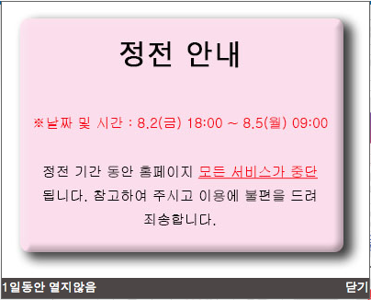
Blackout Period
This probably doesn’t happen with EVERY test. It seems like a period just for regularly scheduled maintenance.
날짜 및 시간 = Date and time
From Fri, Aug 2 at 6:00pm to Mon, Aug 5 at 9:00am, all services on the website will be unavailable.

Slide 6
TOPIK Homepage (www.topik.go.kr)
Close the announcement popups.
Click “수험표출력” (the button with the printer) to print your ticket.
(Or go up in the top menu to 시험응시, then 수험표출력

Slide 7
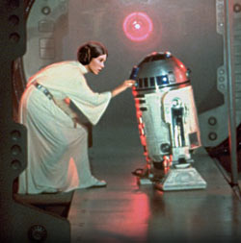
Download & Install
An ActiveX control will also appear in IE…
(If you haven’t already done it…)
This page will prompt you to install:
An ActiveX control (at top)
XecureWeb (button)
Install both to continue.
(i.e. Internet Explorer = your only hope)

Slide 8
Login to access your test ticket!
(Leave the “일반회원” button checked. That means “Regular Members”. The other button is for “Managers”.)

Slide 9
Find your ticket and print it.
#1 = Click “시험 응시” then “수험표 출력” (if you haven’t already).
#2 = Click the “수험표 출력” button to print your ticket.

Slide 10
Example Test Ticket
The following image shows what your test ticket should look like.
You’ll need that when you show up on test day.

Slide 11
PART 2: What to Expect

Slide 12
#1: Entrance and exit times
Arrive and be seated 20 minutes BEFORE test time.
You may not exit the room during the test without a good reason.
With permission, you can leave 10 minutes before the end of the test.

Slide 13
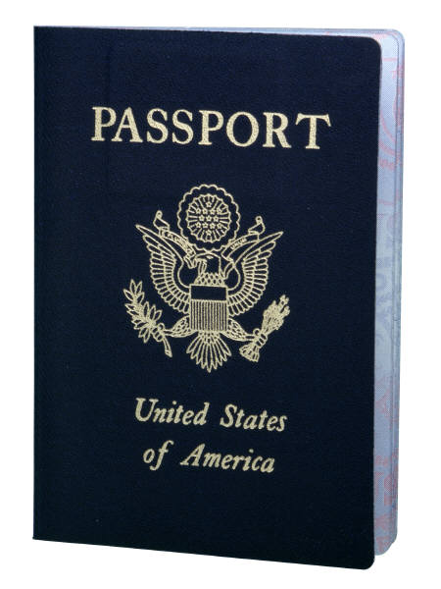
#2: What to bring
You must bring:
The test ticket (print it out during the proper period).
Your ID
Passport
Resident ID
Foreigner ID
Driver’s license
You must place both of these on the upper-left corner of your desk during the exam.

Slide 14
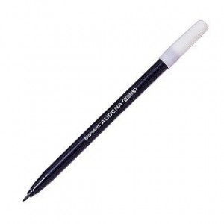
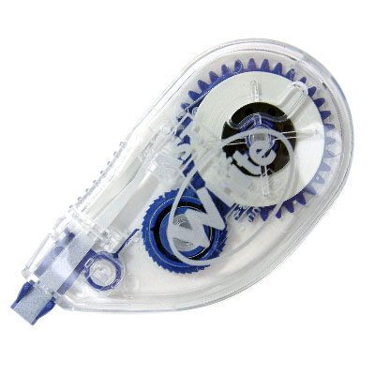
Join form
#3: How to fill in the answers
Fully fill the OMR circles with a “sign pen” (사인펜)
Do not use a pencil or another kind of pen (otherwise INVALID)
If you make mistakes, use whiteout tape (수정테이프)
Writing answers can be written with pen or pencil
Fill in Writing answers in the proper sections on the test answer sheet (essay on the back)
Correct writing mistakes with an eraser, a double-line strikethrough, or whiteout tape
Questions with 2 or more answers marked = INVALID
Applicant # and name should be filled in correctly and carefully
You can ask for a new OMR card, but must turn it in promptly when the test finishes, complete or incomplete
Know the proper way to fill in the OMR card (above)
Failure to use the right kind of pen (사인펜) or marking incorrectly and receiving a bad score is no one’s fault but your own.

Slide 15
#4: Cheating
At the end of the test:
Put the pens on the desk
Answer on the right corner
Booklet on the left corner
(Follow everyone’s example)
Cheating = INVALID test
Types of cheating:
Looking at/showing answers
Using memos or test books
Using cell phones, MP3 players, radios, electronics
Forging ID/paperwork
Taking the test for someone
Taking notes/recording sound to pass on to others
Disturbing the test/not complying with supervisor
Other violations (even those discovered after the fact)

Slide 16
PART 2: Where to go

Slide 17
Test Location
Next slide
In Korean: 시험장 안내
In English: Test Sites
1. Locate this page of the website and scroll down to find your test location.
2. Click on the link for your test location and it will pop up a map showing you where to go (next slide).

Slide 18
Jeonbuk University Campus
In my case, it looks like I should probably go to the LEC (Language Education Center – 언어교육원) first to register, and from there they will most likely direct me to my testing room. I’ve read that there should be plenty of signs and staff members with bright sashes or badges to help direct the test takers.

Slide 19
Part 4: Taking the Test

Slide 20
Now that you’re in and seated 20 minutes early, you probably want to mentally prepare for it! Good luck on TOPIK!

