Slide 1
How to Register for the FREE KIIP Korean Class (사화통합프로그램)

Slide 2
Part 1: Join the Website

Slide 3
1. Go to www.socinet.go.kr
On the Soci-Net homepage, click “회원가입/Join” to Register.

Slide 4
Agree to Terms

Slide 5
If using Chrome… (which by the way, won’t work later)
Google Chrome warned me that the site is “unknown” or “not trusted” or something. If you get this message, just click the first link that says “Go in anyway.”

Slide 6
Change to your preferred language

Slide 7
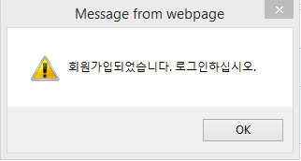
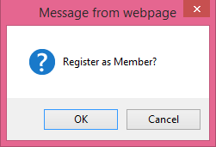
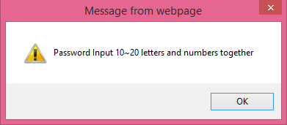
Check that you can use your chosen ID
SUCCESS!!
This is a common function on ALL Korean websites. You have to be sure that your username isn’t already taken.
After entering all your info, “Confirm Duplication” to check that you can use your ID.
After confirming your ID, Click Join. **Use IE. This didn’t work in Chrome.**
Also, be sure you password is 10-20 letters and numbers.

Slide 8
Next step, Log in!
(FYI: You should probably use Internet Explorer for everything. This is Korea, after all…)
**Note: ALL steps worked for me in Windows 8, IE 11

Slide 9
Part 2: Register for Pre-test

Slide 10
Register for the Pre-Test
Once you login, you need to find the link at the top of the page called “사회통합프로그램” (that’s the name of this program)
Under there, click “사회통합프로그램 신청” to register. The other two links highlighted there are related, but don’t let you register.

Slide 11
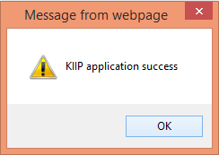
Apply!
Again, you can change everything to your language of choice.
I’m honestly not sure what “The Final Education” is about there, so I just put in info about my Master’s Degree. Not sure if they wanted my Korean language study. Anyway, I don’t think it matters a big deal.
Just (1) Fill in your info, (2) Agree, and (3) Apply

Slide 12
My Page (finally)
Next, you’ll be taken to my page where you have a few more things to do.
Vicarious class application
Deputizing attendance application
Checking detailed user information

Slide 13
1. Vicarious Class Application
Click the first link (highlighted earlier) and select the location you (apparently) want to take the Pre-Test from.
I choose Wooseok University because it’s closer to my house (in Jeonju).
There is also Wonkwang University in Jeollabuk-do.

Slide 14
2. Deputizing Attendance Application
Same-same. Again, click your preferred location.
(Wooseok University for me!)

Slide 15
FINISHED! (~almost)
Great! Now, all your information is filled out on “My Page”! There’s only one thing left to do (and you have two ways to do it). Print your Pre-Test Ticket.

Slide 16
Part 3: Print your ticket

Slide 17
3. Checking Detailed User Information
If you click your “Detailed User Information” you’ll probably be impressed with what it pulls up. This pulled up my marital status and VISA type.
Anyway, click “응시표” to print your ticket.

Slide 18
Install Active-X
When you click to Print your test ticket, it will (like ALL Korean websites do) prompt you to “Install Active-X.” Do it. You know you want to.
My Windows 8 computer with IE 11 ended up prompting me for SEVEN controls to install. I did ㅠㅠ… And then I got this! (next slide)

Slide 19
Ta-Da!
Print it out and be prepared to present THIS at your test time and site. Details:
You need to take THIS ticket, a picture ID, and a sign/name pen
Enter the test room up to 30 minutes BEFORE the test
Results will be posted on “My Page” 7 days after the test – from there, register for a class I suppose

Slide 20
Part 4: Taking the Test

Slide 21
Now that you’re all set, just show up on time and do your best! Good luck!

