Slide 1

How to Apply for KIIP Classes (사화통합프로그램) After the Pre-Test

Slide 2
Part 1: My Page (마이페이지)

Slide 3
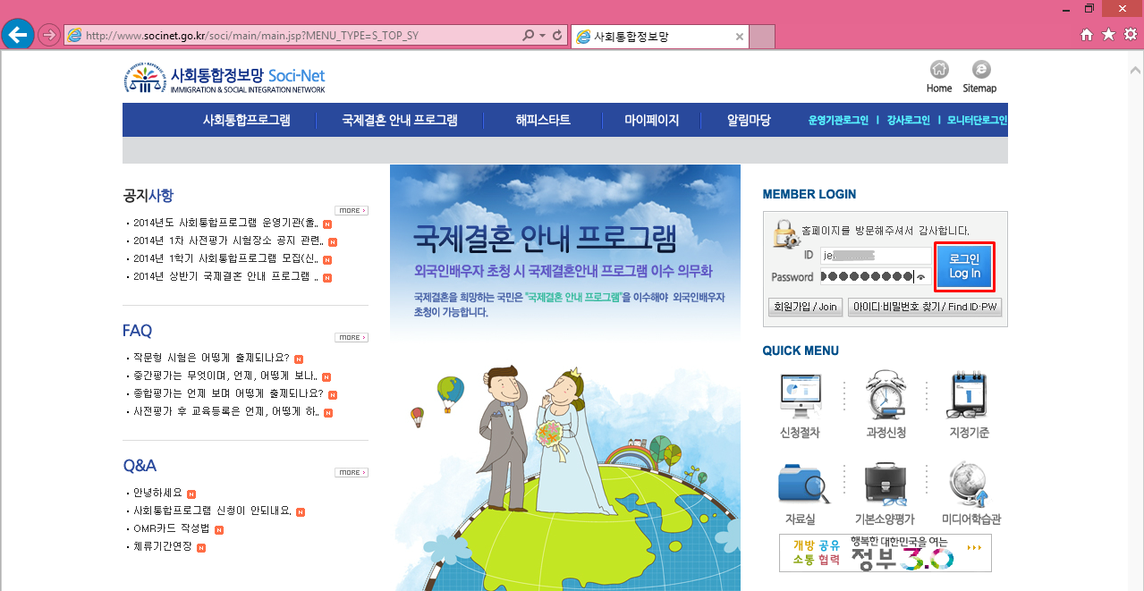
1. Go to www.socinet.go.kr
Login!
(FYI: You should probably use Internet Explorer for everything. But, ALL steps worked for me in Windows 7 & 8, IE 9 & 11, and on Mac Mavericks)

Slide 4
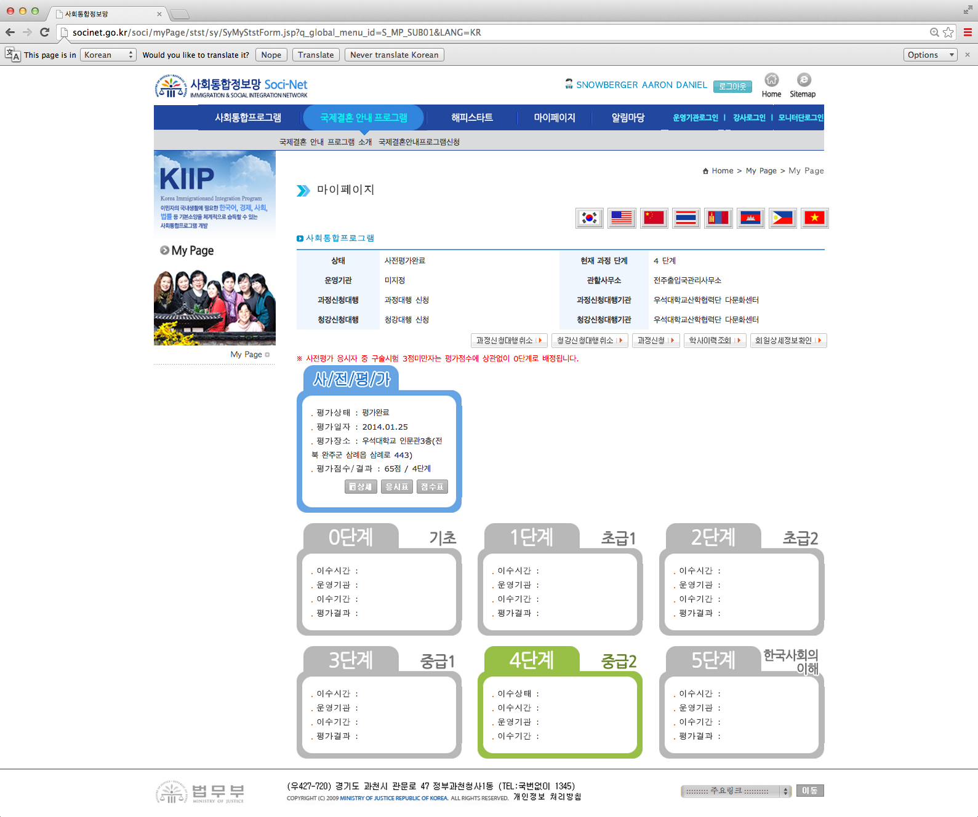
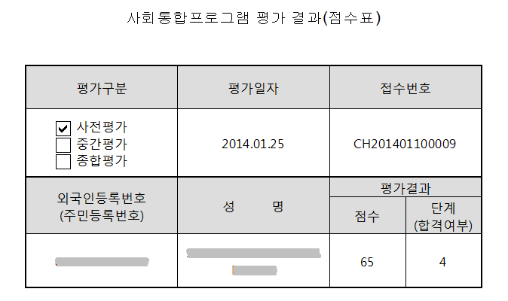
2. Go to My Page (마이페이지)
Check your Level. (Level 4 – Wow! Seems a little intense maybe…)
If you want, click the button in your blue stats box to get a Printable PDF-type version of your score (you’ll need to allow installation of about 7-8 ActiveX type scripts).

Slide 5
3. Click on the Button for Apply Class (과정신청)

Slide 6
Part 2: Apply for class

Slide 7
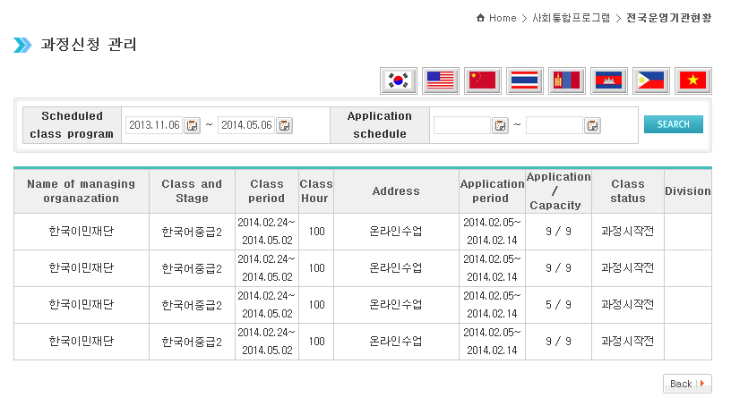
4. Select a Class
Be mindful of the Application/Capacity numbers.
It looks like Online classes are limited to 9 students.
(I clicked EACH link to see the times, then registered for the only available one. I figure someone will drop eventually, so I want to know which slot to watch.)

Slide 8
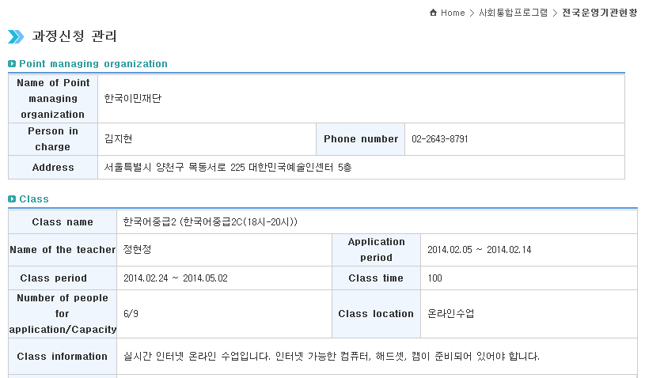
5. Check the Class Info
Under “Class Information” there it says:
“This is an Online class. Prepare an Internet-ready computer, headset, and camera.”

Slide 9
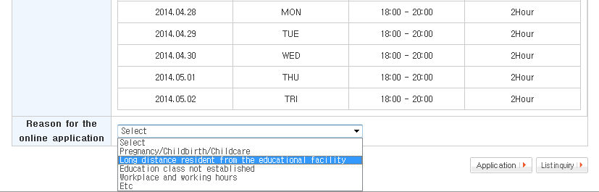
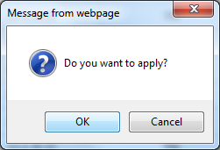
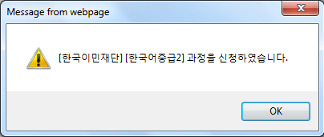
6. Give a reason for your Online application
(You’re in!)
Scroll to the bottom of the page and select a reason for your Online app.
(Actually, they expect you to come to an available center nearby I guess. I literally got a phone call from Woosuk University to talk to me about applying for a class there about 10 minutes after I applied online.)

Slide 10
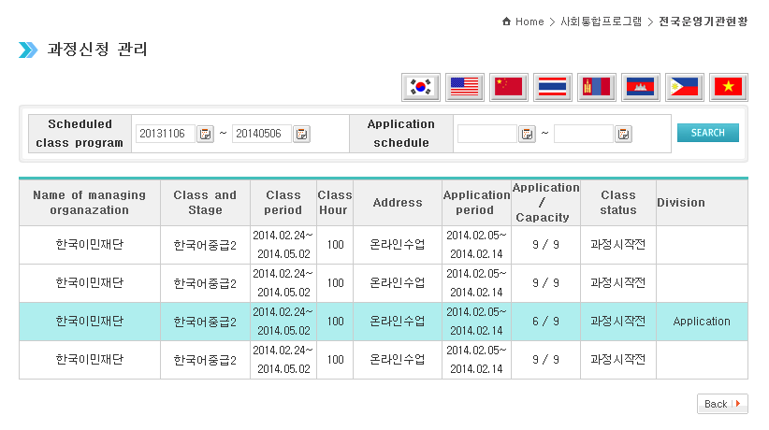
7. You’re In!
Success! You’re in! Now just come back to this page on the class date at the class time for your first lesson (I guess… We’ll have to see how it goes.)

Slide 11
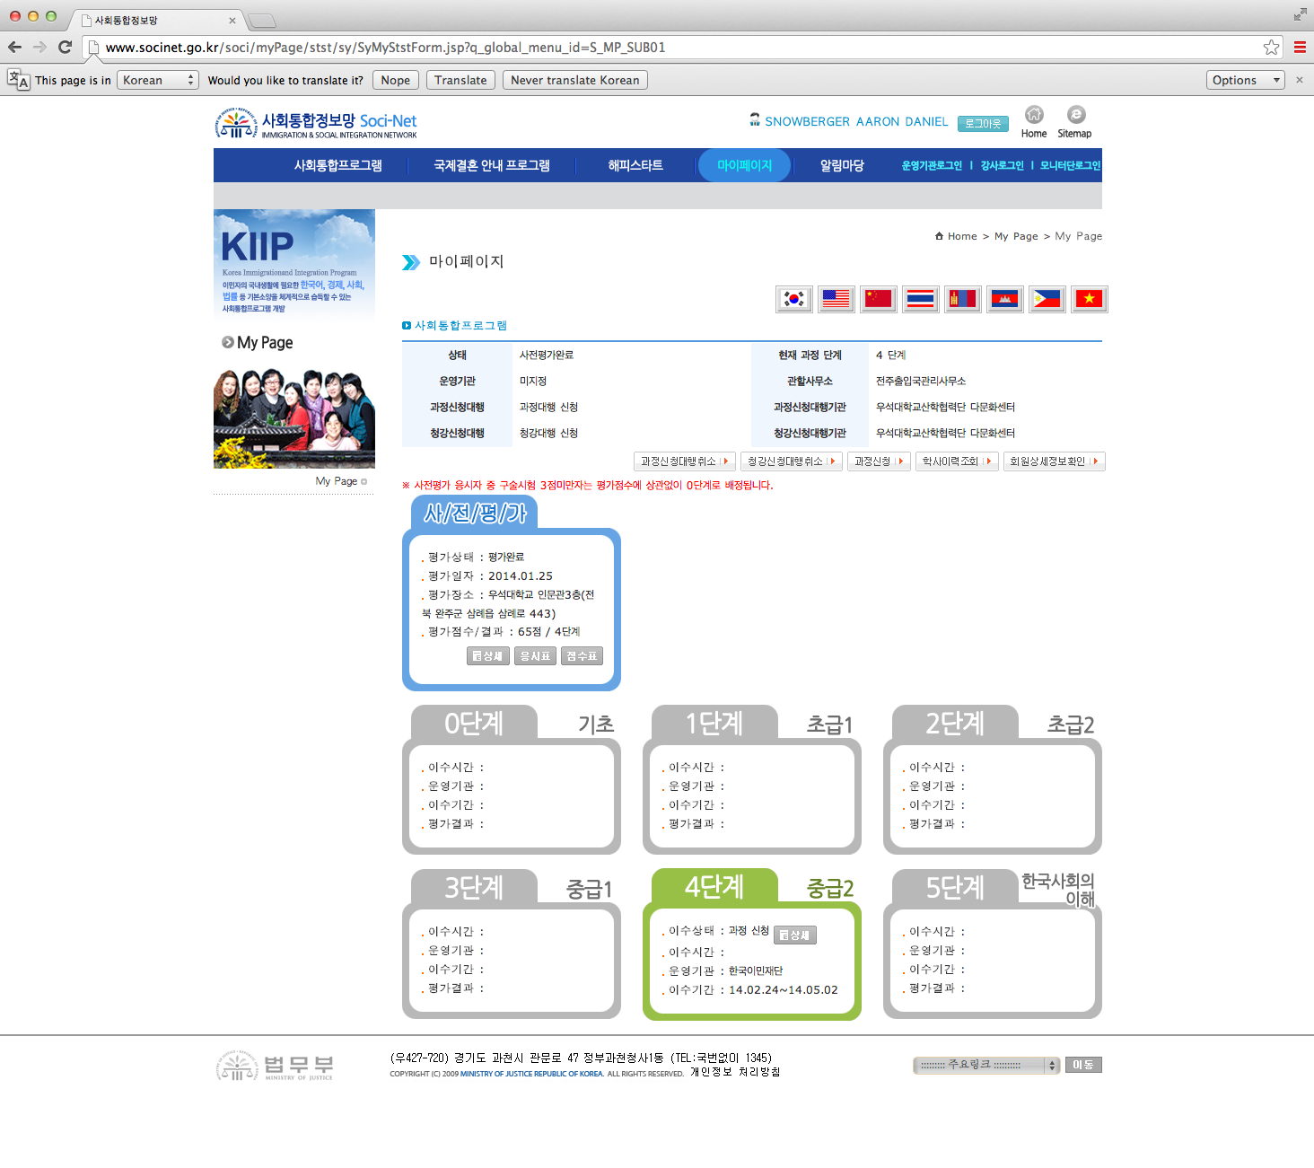
8. My Page again
Now you’ll notice your class input into the box with your Level.
Congrats! And good luck sticking with this big time commitment!

Slide 12
Remember that you need: A computer, a mic, a camera to take the class. Good luck!

