Slide 1



“Quick Korean”
http://korean.cuk.edu

Slide 2


Slide 3
WHY
is this awesome?

Slide 4
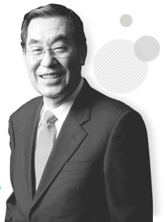
“I have developed a special interest in Korea’s multicultural families, not only because I studied as a minority nonnative scholar in the United States for 36 years, but also because my own family is multicultural, too.”
Choong Soon Kim, Ph.D.
President, The Cyber University of Korea

Slide 5



Excellent Foundation
고려대학교
김성수
고려중앙학원
(Foundation)
고려사이버대학교
김병관 (grandson)

Slide 6







Notable Backers

Slide 7
Long History
2001
2007
2012
2013
2014
*
April 20
July 19
December 4
August 25
Online foreign language edu start
“e-Learning Campaign for Multicultural Families”
Degree track for BA in Korean Teaching
Launch of “Quick Korean” with Level 1
“Quick Korean” Level 4 completed
*(first sponsors)

Slide 8







1st: “Multicultural Campaign” (2007)
Levels
1
7
Languages
Korean Chinese Vietnamese Japanese English Mongolian Thai

Slide 9

2nd: “Quick Korean” (2013)
Levels
1
4
Languages
Korean Chinese Japanese English Spanish*
*(work in progress)

Slide 10
“Quick Korean” Growth
Level 4
Level 3
Level 2
Level 1
August 25
October 22
L1 Spanish filming begins
April 28
January 20
December 4
Dec 13 Jan 14 Feb Mar Apr May June July Aug Sept Oct 14

Slide 11
Impressive Numbers
110,693
people
71
countries
50-100
weekly registrations
705
cities

Slide 12



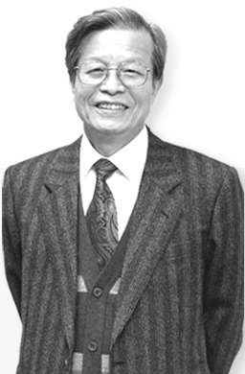



Top Scholars
1
2
3
4
5
6
7
8
Prof. Hyunhwa Kang (2, 5, 6)
Prof. Mijin Won (2, 3)
Prof. Yumi Kim (4, 7)
Prof. Eunkyung Nam (1, 7)
Prof. Jeongeun Kim (1, 7)
Prof. Kishim Nam (1, 2, 8)

Slide 13
FREE!
Need I say more?

Slide 14
WHY
learn Korean?

Slide 15

13th
Most spoken
80
13th
Largest GDP
million speakers

Slide 16



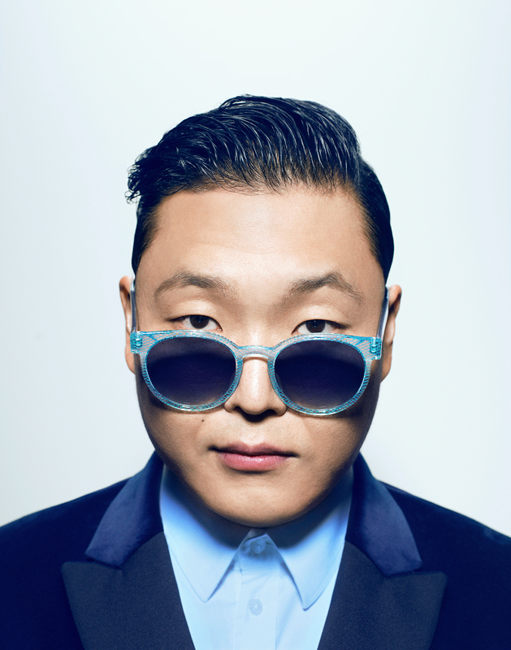

Not to mention...
6th
*Even pop culture
Largest Exporter*

Slide 17
WHY
“Quick Korean”?

Slide 18
Vision
“Access to quality higher education is a right that should be available to everyone. Learning is a lifelong process, an enlightening experience that goes well beyond the early stages of youth.”

Slide 19
Reasons for Creation
1
2
3
4
CUK teaching languages online since 2001
Over 110,000 students need access from anywhere
“Hallyu” & immigrant interest increasing
Increasing foreign academics

Slide 20

Content
1
4
Up to TOPIK Level 3 Vocab
Up to TOPIK Level 4 Grammar

Slide 21

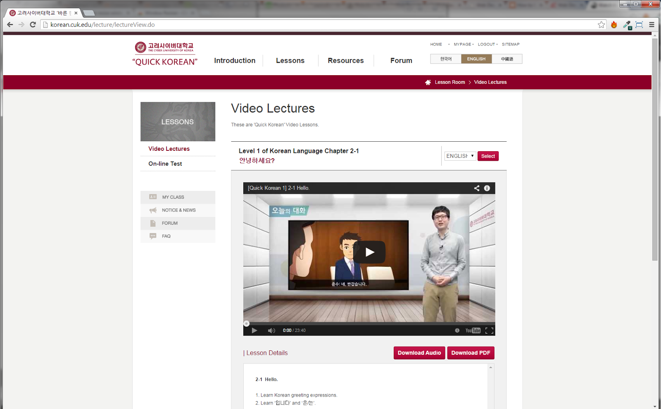
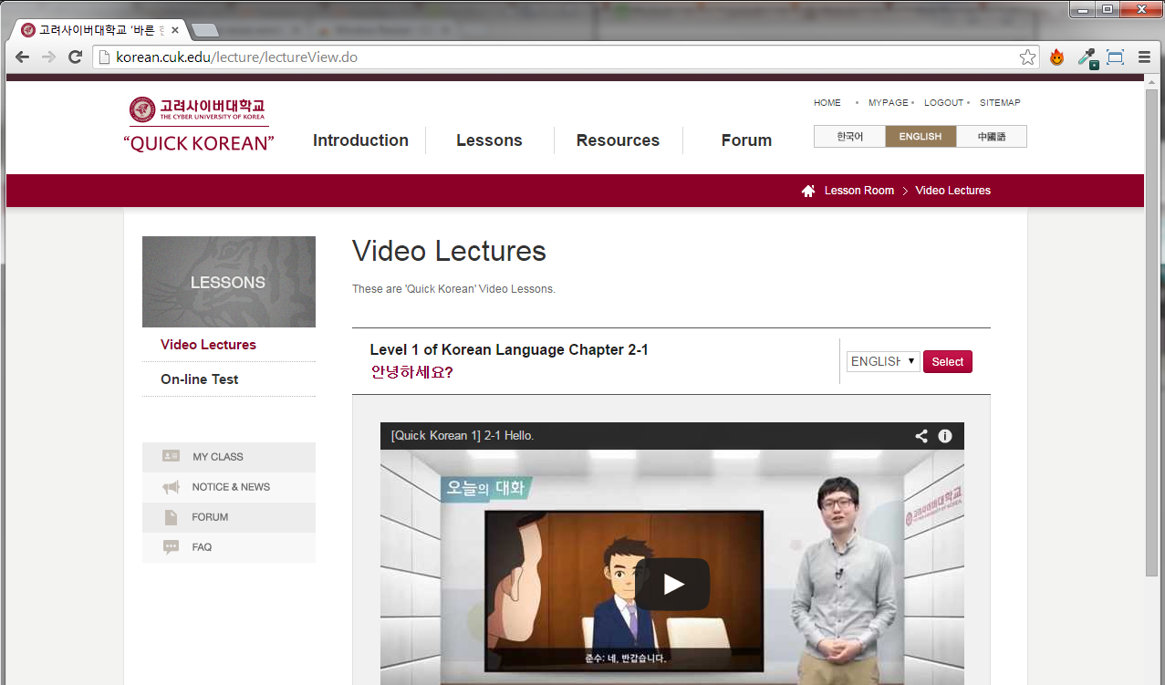
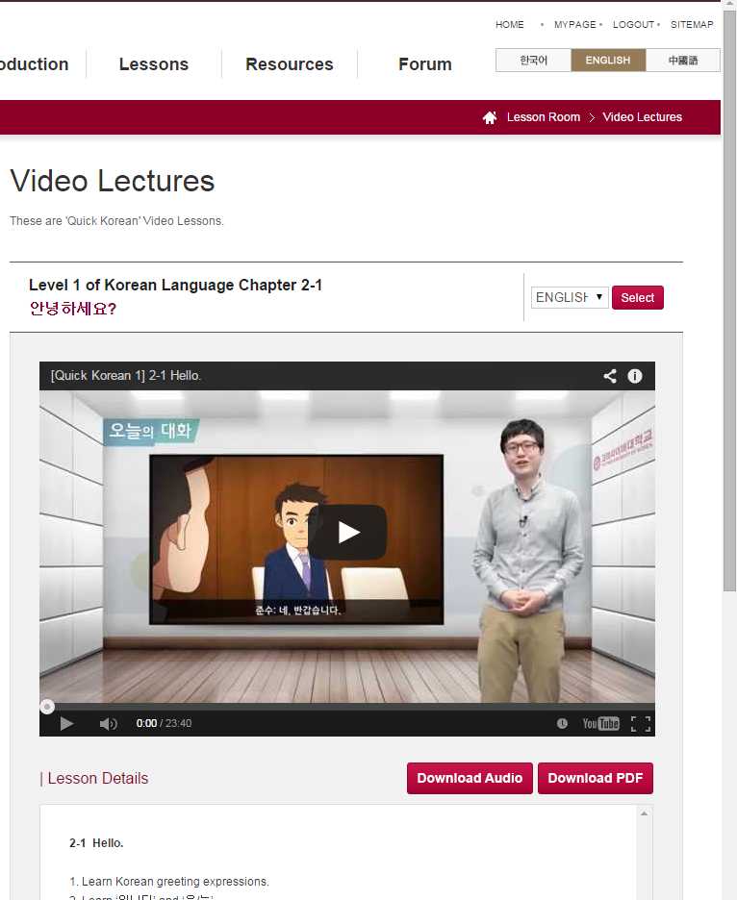
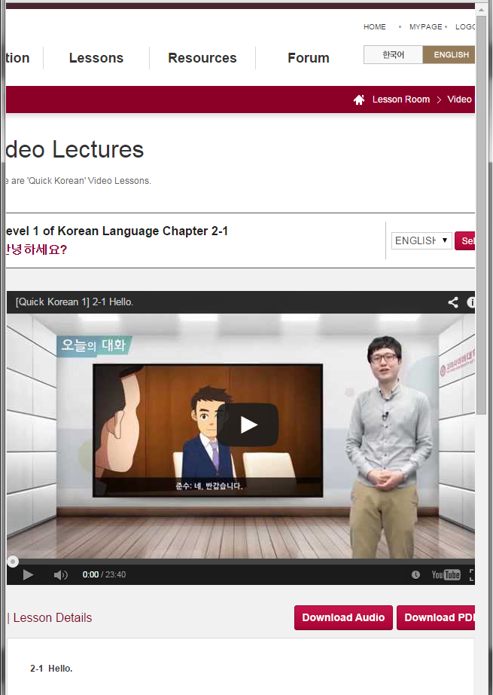
All
Devices

Slide 22
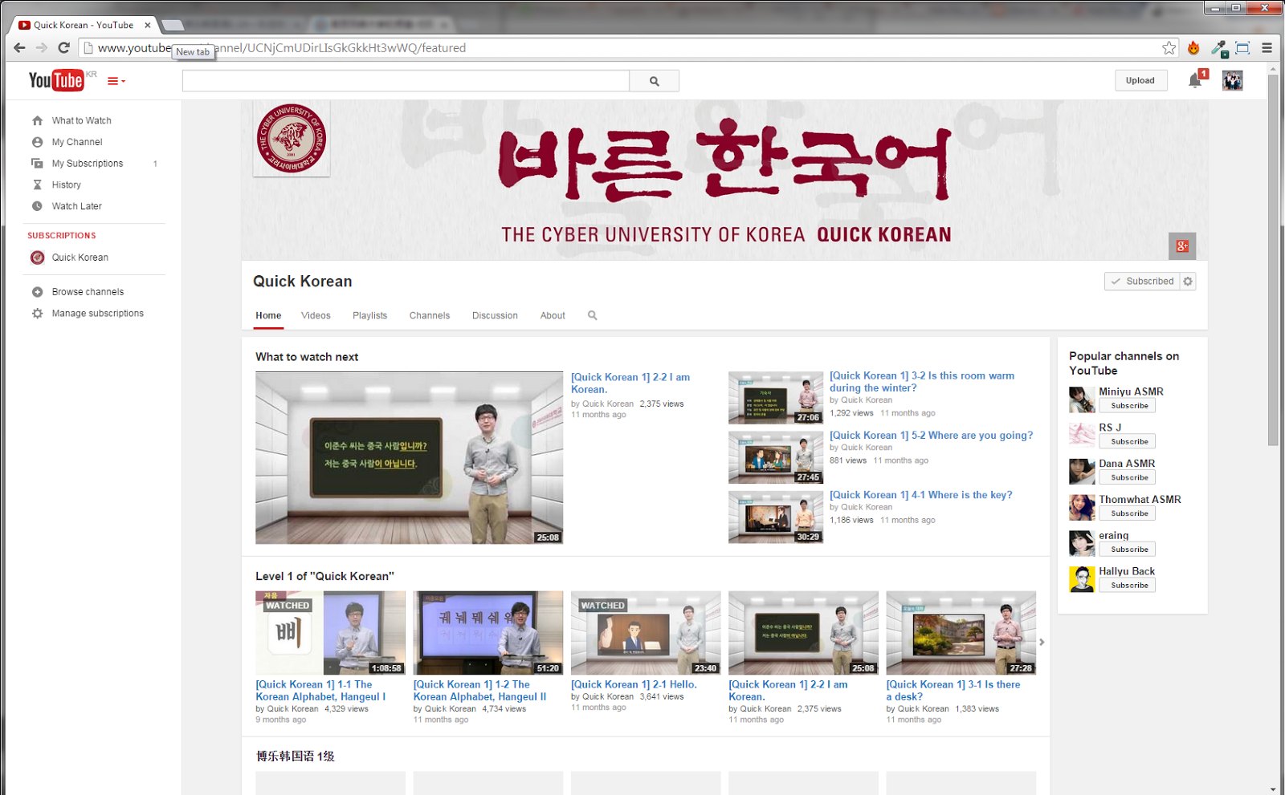
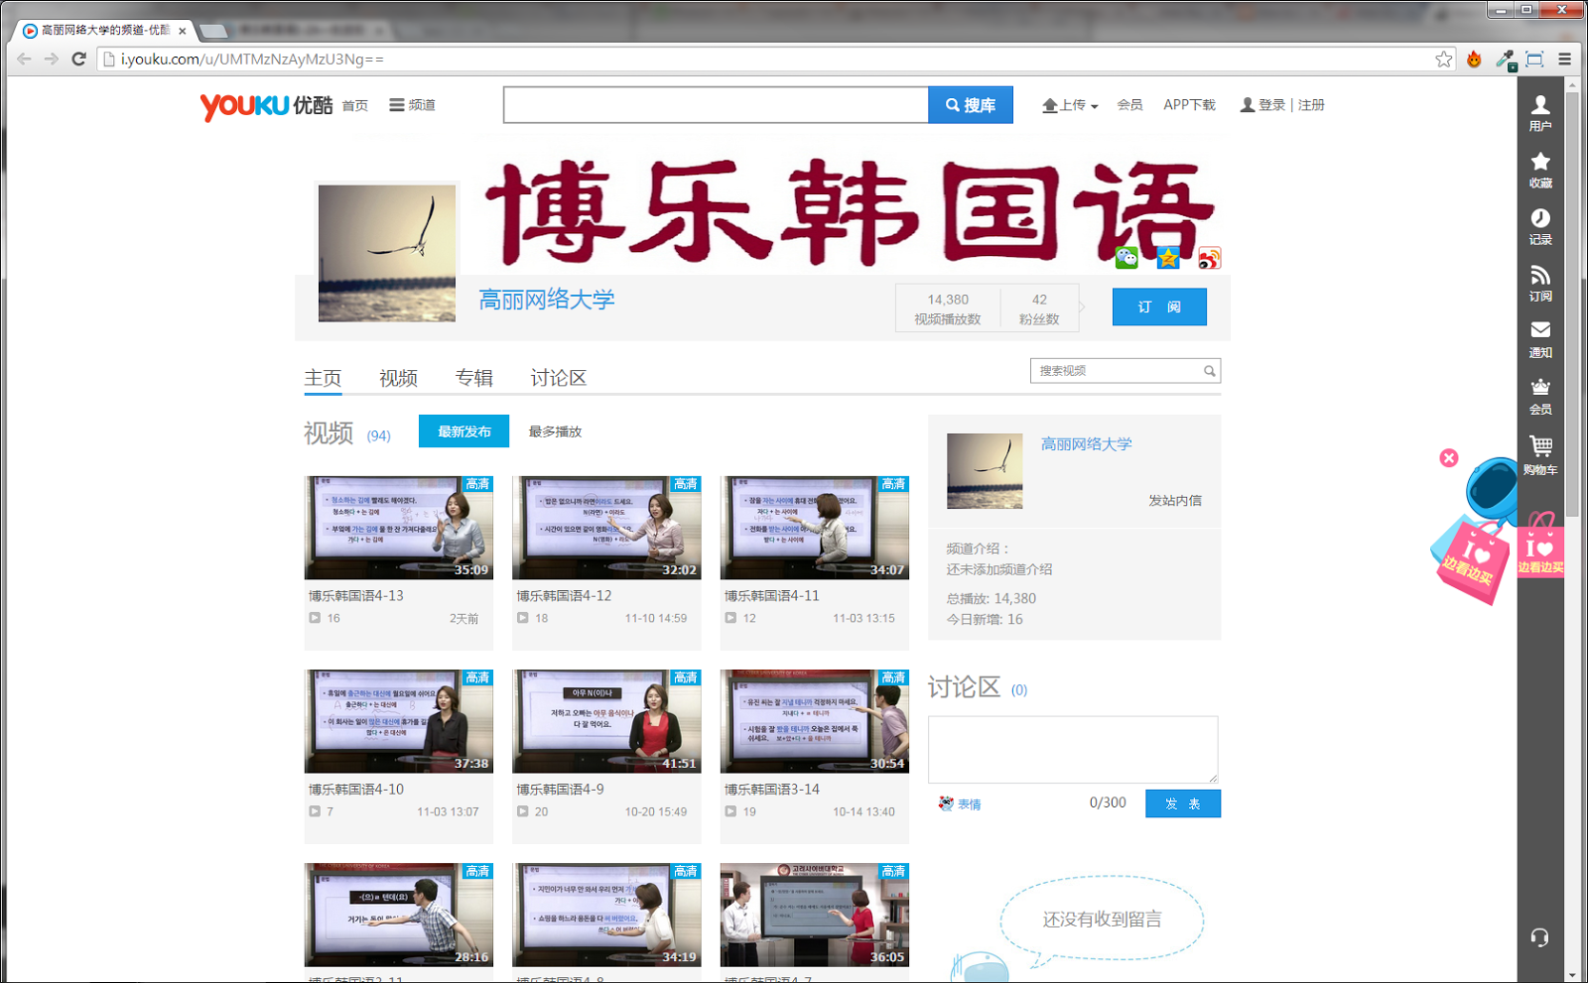
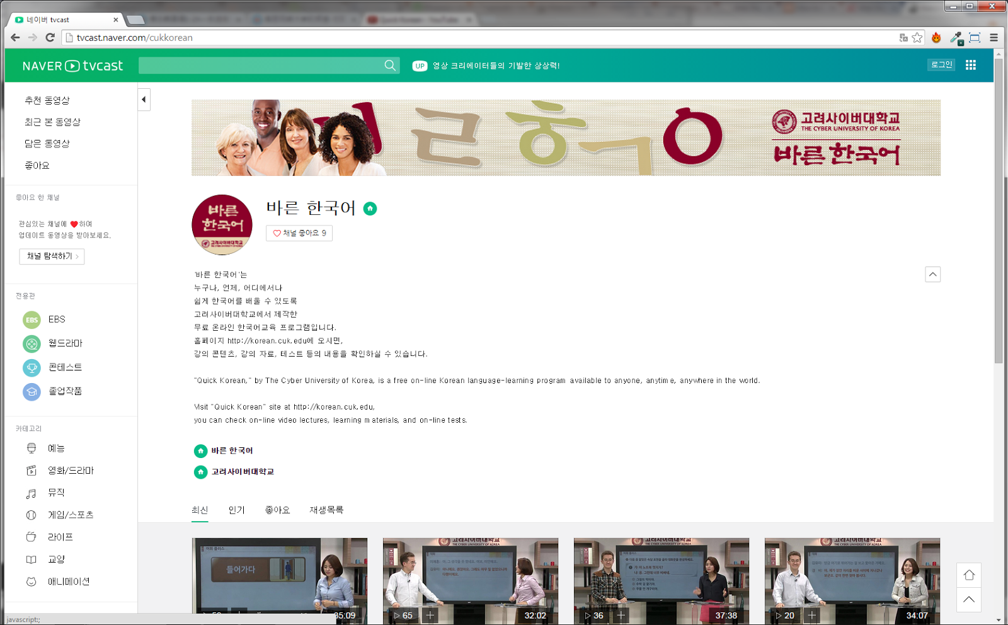



Dedicated Channels
support: May 8, 2014
support: May 9, 2014

Slide 23
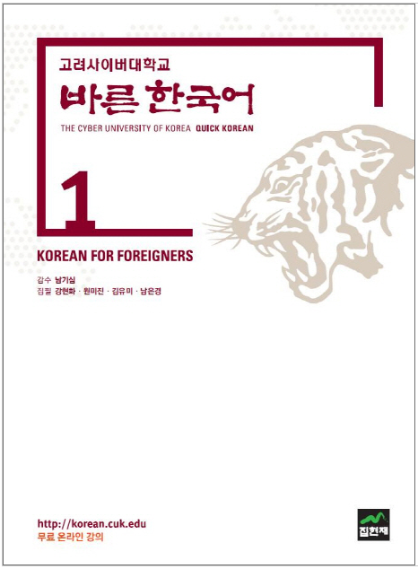
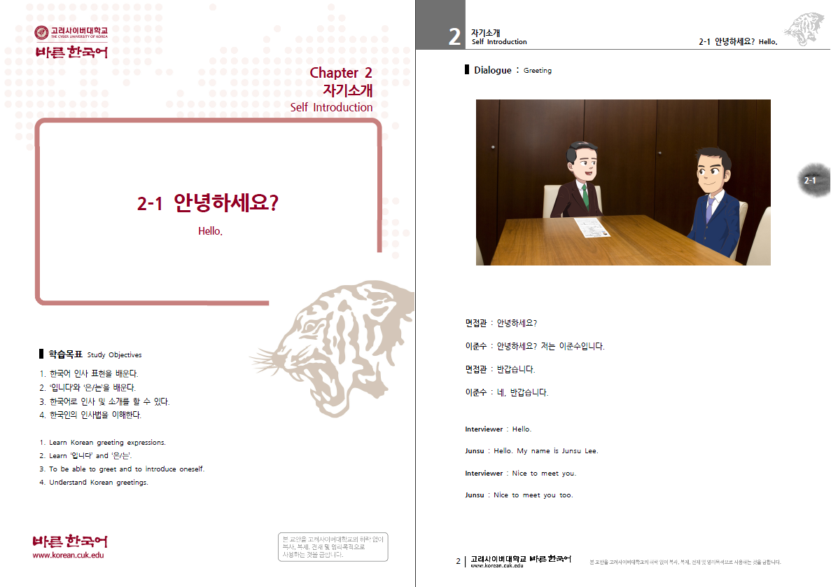

Downloads & Textbook

Slide 24
Levels: Breakdown
1 2 3 4
Beginner Elementary Intermediate Advanced
Lessons | 30 (15x2) | 30 (15x2) | 20 | 13
Time | 696 min (11.6 hr) | 773 min (12.9 hr) | 585 min (9.75 hr) | 463 min (7.7 hr)
Video | KO, EN, CN, JP, SP* | KO | KO | KO
Site | KO, EN, CN, JP | KO, EN, CN | KO, CN | KO
Downloads | Audio, PDF | Audio, PDF | Audio, PDF | ---
*(work in progress)

Slide 25
Total Instruction
93
Lessons
2,517
min
42
hours

Slide 26
Levels: Content
1 | 2 | 3 | 4
Daily activities Fundamentals of social interaction | Location-based conversations Expressing preferences, opinions | Casual conversation Topics: work, hobbies, relationships, family | Free & fluent speech Public speaking

Slide 27
Lessons: Content
Objective
Conversation
Vocab
Text
Grammar
Speaking
Listening
Extra Vocab
Culture
Summary
1
2
3
4
5
6
7
8
9
10

Slide 28
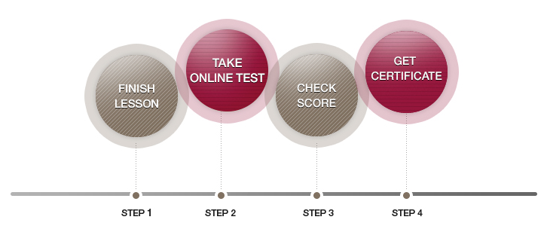
Process

Slide 29
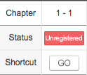
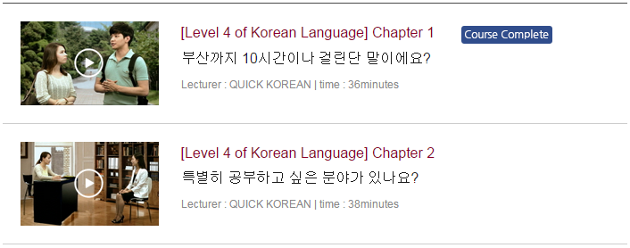
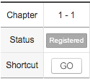
Completion
Test Page
Video Lectures: Simply clicking the link produces

Slide 30
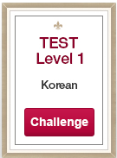
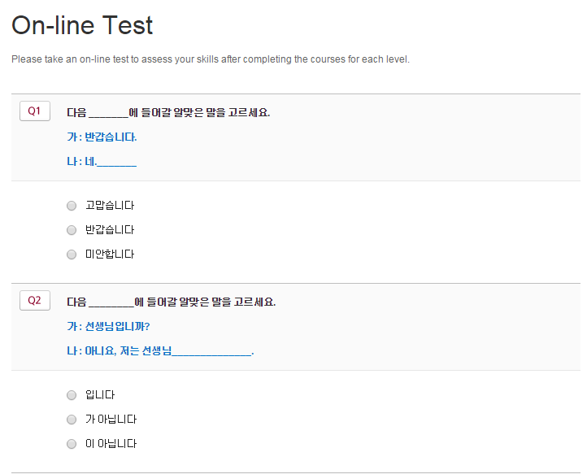
Testing

Slide 31
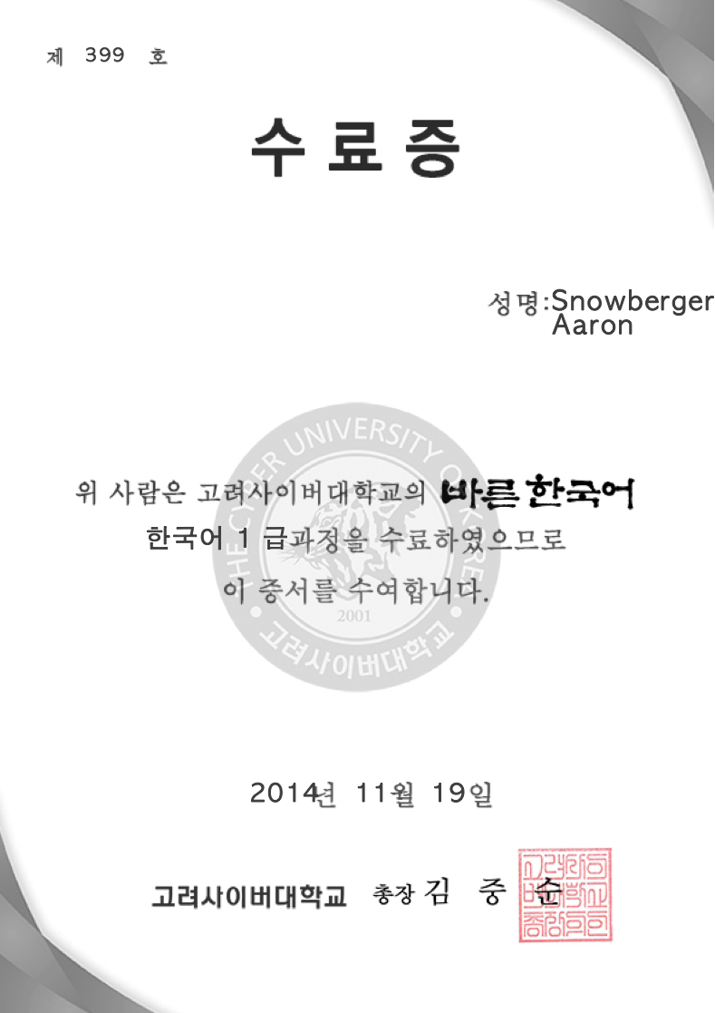
SUCCESS!

Slide 32
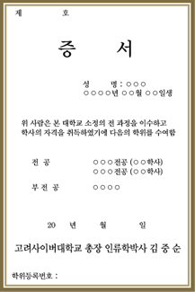
But that’s not all~
Accredited BA in Korean Language +
Teaching Certificate awarded by MCST if attending CUK.*
*(not available in )

Slide 33
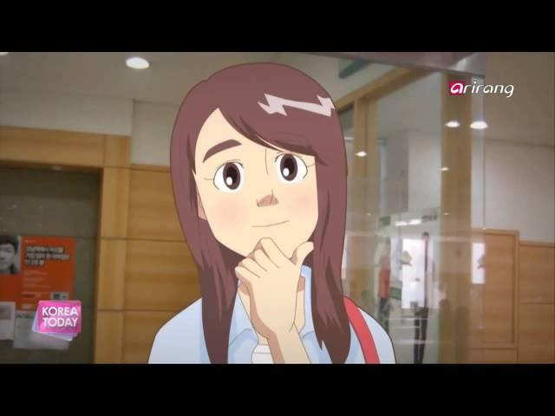

Slide 34






Resources
http://korean.cuk.edu/
https://www.facebook.com/qkorean
https://twitter.com/koreancuk
https://plus.google.com/103194811974596017904
http://www.youtube.com/channel/UCNjCmUDirLIsGkGkkHt3wWQ
http://tvcast.naver.com/cukkorean
http://i.youku.com/u/UMTMzNzAyMzU3Ng==

